Slide 1
Compressed Sensing:
What is it good for ?
(a course on inimaginable wonders and how to make them work for you)
Igor Carron
Version 1- work in progress / draft

Slide 2
News #1: Everything is a linear system of equations
Most of your working life will be about solving linear systems of equations
  Get used to it !
  If it’s nonlinear, then approximate it to make it a linear system of equations
  If it’s continuous, then discretize it to make it a linear system of equations
  If it’s blablablah, then … you’re smart, you get my drift.

Slide 3
Different Linear Systems of Equations
They are either:
  Overdetermined: Too many equations and too few unknowns
    Solution: least squares, remove equations
  There are as many equations as there are unknowns
    Sweet spot, we want to be there.
  Underdetermined: Too few equations and too many unknowns
    We care about this case only from now on

Slide 4
Underdetermined System of Linear Equations
  Too few equations and too many unknowns
    -> Infinite number of solutions
      What The Hell ?
      Too many choices, my head is going to explode

Slide 5


Within an infinite number of solutions some of these solutions are:
Cute (compressed sensing can’t help)

Slide 6

Within an infinite number of solutions some of these solutions are:
Fractal (compressed sensing can’t help)

Slide 7

Within an infinite number of solutions some of these solutions are:
Positive (compressed sensing can’t help, not right away at least)

Slide 8
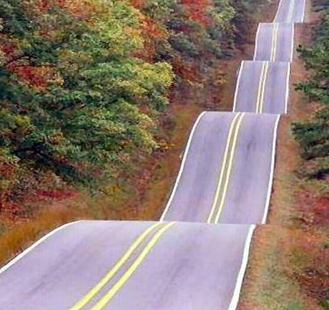
Within an infinite number of solutions some of these solutions are:
Bumpy (compressed sensing can’t help, not right away at least)

Slide 9
Within an infinite number of solutions some of these solutions are:
Blahblahblah….

Slide 10

Within an infinite number of solutions some of these solutions are:
Sparse (compressed sensing can help)
  Compressed Sensing reconstruction techniques allows one to find a solution that is sparse i.e. has the property of having very few non-zeros elements (the rest of the elements are zeros).

Slide 11
Meaning of Compressed Sensing
Compressed = Few
Sensing = equations / linear combinations
An instance of an underdetermined system of linear equation is a compressed sensing system.
The recovery of a sparse solution to an underdetermined system of linear equations is performed using Compressed Sensing Reconstruction techniques /solvers.

Slide 12
Compressed Sensing
Do all underdetermined systems of linear equations admit very sparse and unique solutions ?
Ans 1: No
Ans 2: Do you really really care ?
Ans 3: How do you find which one that do ?
  Go to the next two slides

Slide 13

Do all underdetermined systems of linear equations admit very sparse and unique solutions ?
Some systems do, but they need to fulfill a condition (RIP, NSP,….) that cannot be checked (immediately).

Slide 14
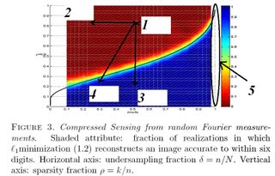
Do all underdetermined systems of linear equations admit very sparse and unique solutions ?
Yes, if they recover sparse solutions following Donoho-Tanner phase diagram.

Slide 15
Summary
Compressed sensing is about setting up underdetermined systems of linear equations.
Compressed Sensing Reconstruction techniques are about finding the sparsest solution (out of an infinite number of solutions) of that system.

Slide 16
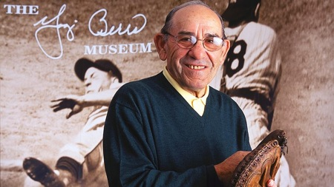
Summary (part II)
The underdetermined systems that have sparsest solutions are the ones that have sparsest solutions.
Yogi Berra would be proud!

